Slide 1
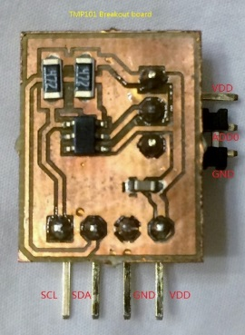

Lecture 17 Verilog uart ip and Lab #9 Part 2
Verilog uart Modules from Xilinx uart sources
Make an IP for the uart module
Clock Sources for PL circuits
Add the uart IP to Repository
Include the uart module IP in the block design from Lab #9 Part 2
Clock and reset for the uart IP
Launch SDK and write C code to read two TMP101 sensors and display the values in C and F to both custom uart terminal and standard terminal

Slide 2
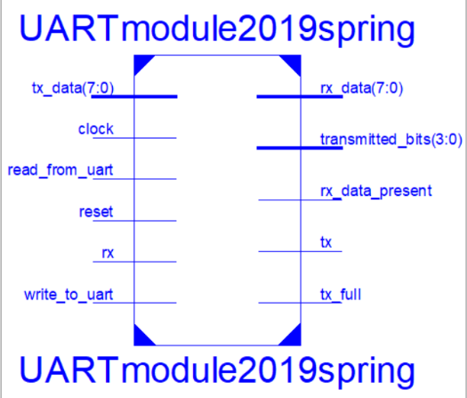
UART Module UARTmodule2019spring.v
Read_from_uart and write_to_uart are active high level signals
They are turned into one shot signals in the module
Three parameters are defined parameter TRANSMITTED_BITS=8, BAUDRATE=20'd19200, FREQUENCY=30'd50000000;
To transmit a byte,
Check if tx_full is full, if it is not, place data on tx_data and set write_to_uart to high to put data on sending buffer
To receive,
Check if rx_data_present, if it is read data on rx_data, set read_from_uart to high remove it from receiving buffer

Slide 3
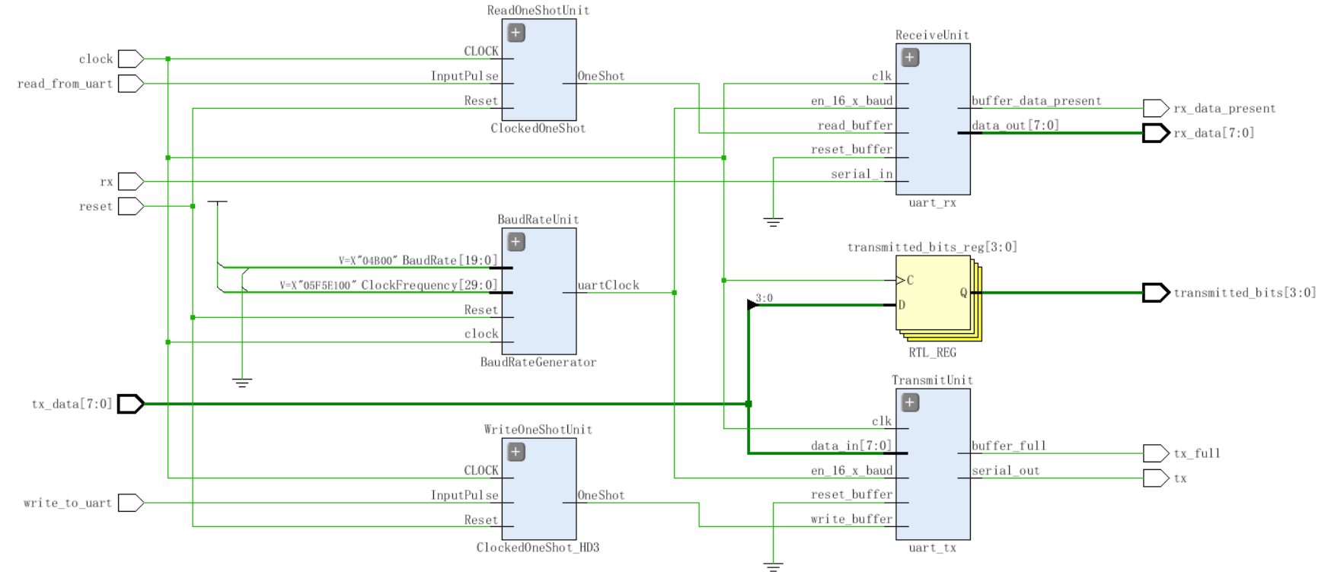
UART Module UARTmodule2018spring.v

Slide 4
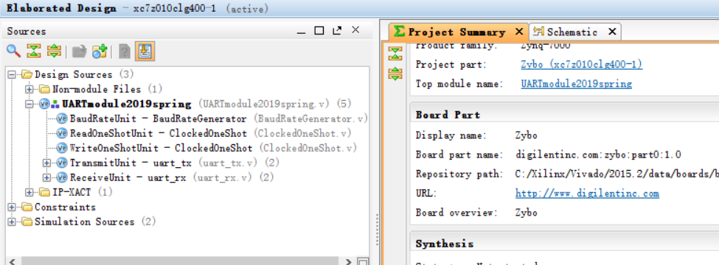
Create a Project for UARTmodule2019spring.v
Create a project for UARTmodule2019spring.v
Create a new RTL project entitled uart_ip.
Select Zybo as the board for this project.
Add all Verilog files for UARTmodule2019spring.v to this project

Slide 5
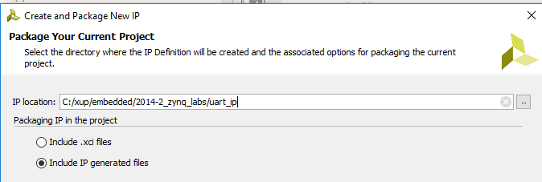
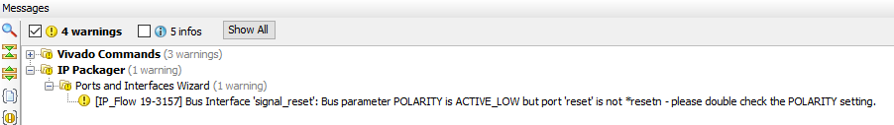
Making an IP of UARTmodule2019spring.v
Tools->Create and Package IP, and Next.
Choose “Package your current project” , Next.
Choose “Include IP generated files” and specify a location for this IP. Next and Finish.
A warning may appear. Reset should be active low. Make this change and repackage this ip. This warning still appears. Ignore it.

Slide 6
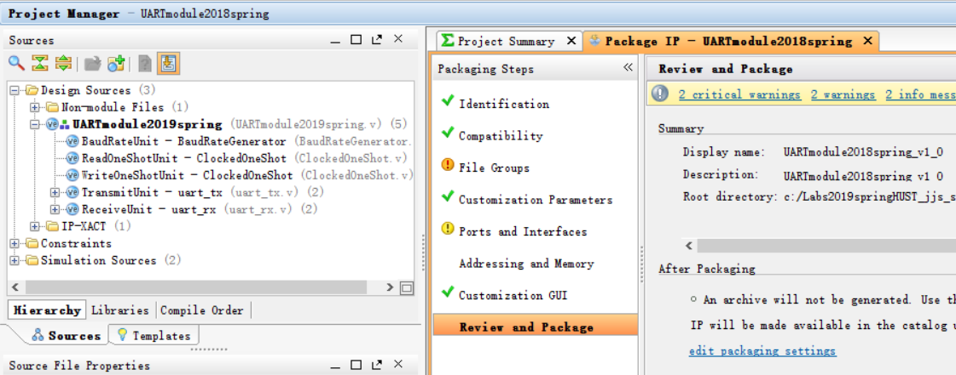
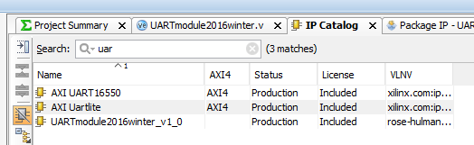
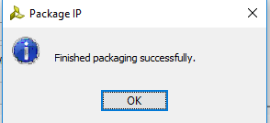
Review and Package the IP
Review and Package -> Choose “Package IP”, Next.
Choose IP Catalog and type UART to see the new ip.

Slide 7
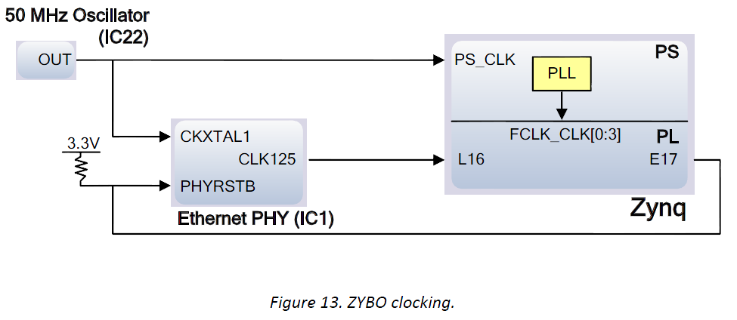
Zybo Clock Sources
50MHz crystal oscillator
The PL has two MMCM (mixed-mode clock manager) and two PLL’s
Four PS reference clocks and the 125MHz external reference can be used to drive PS
Choose to drive PL with FCLK_CLK[0] which also drives AXI blocks.

Slide 8
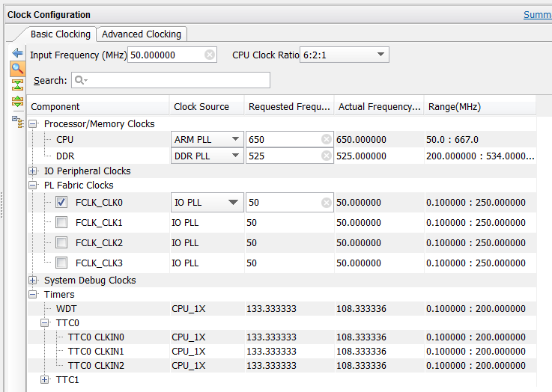
Clock Configuration of Zynq Processing System (5.5)
CPU at 650MHz
DDR at 525MHz
PL Fabric on FCLK_CLK0 at 50 MHz, change this clock to match your uart clock
TTC0 at 133MHz

Slide 9
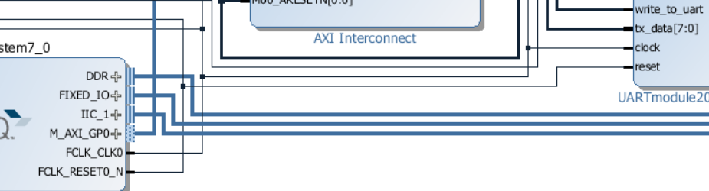
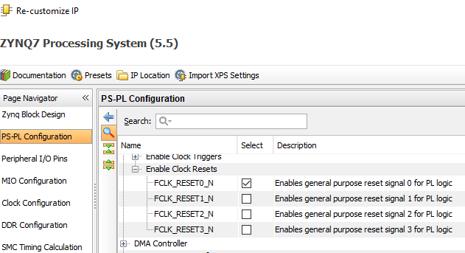
Reset signal
Choose FCLK_RESET0_N as the reset signal for the ip. This signal is active low. Therefore, all resets in the ip must be active low.

Slide 10
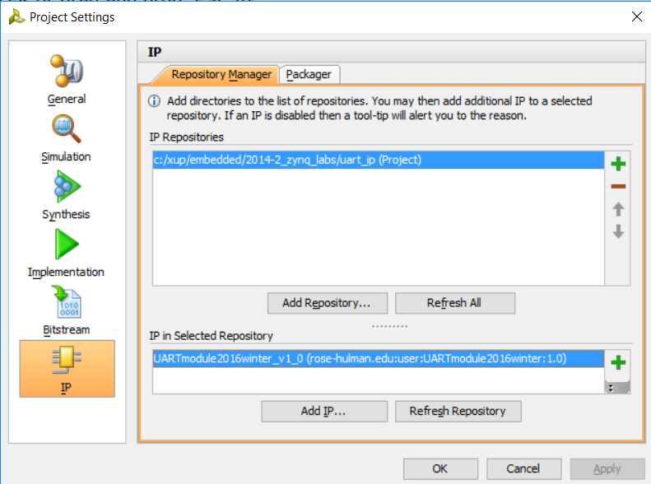
Add IP to Repository of the Vivado IP Catalog
If you cannot see your new ip in your IP Catalog, add it to Catalog.
Click Project Settings, Select IP
Choose Add Repository and uart_ip repository directory
Select the IP
Click Apply. Click OK. Now the ip is ready to be used.
After the ip is changed, the ip component in a block design will need to be updated: right click on the component to open Edit in IP Packager. Repackage this ip and return to your block design.

Slide 11
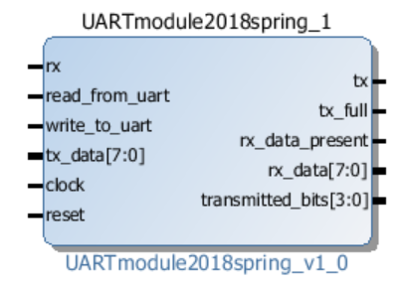
Add the IP and AXI_GPIO block to Zynq block design
Create a project entitled lab9part2I2CuartIP
Create a block design for two I2C modules as in Lab 9 Part 2
Keep or enable M_AXI_GP0, FCLK_CLK0, and FCLK_RESET0_N
Make sure to “Run Block Automation” right after zynq7 processing system is added.
Add UARTmodule2018spring_v1_0 IP to Vivado Repository
Add UARTmodule2018spring_v1_0 IP to the Block Design

Slide 12
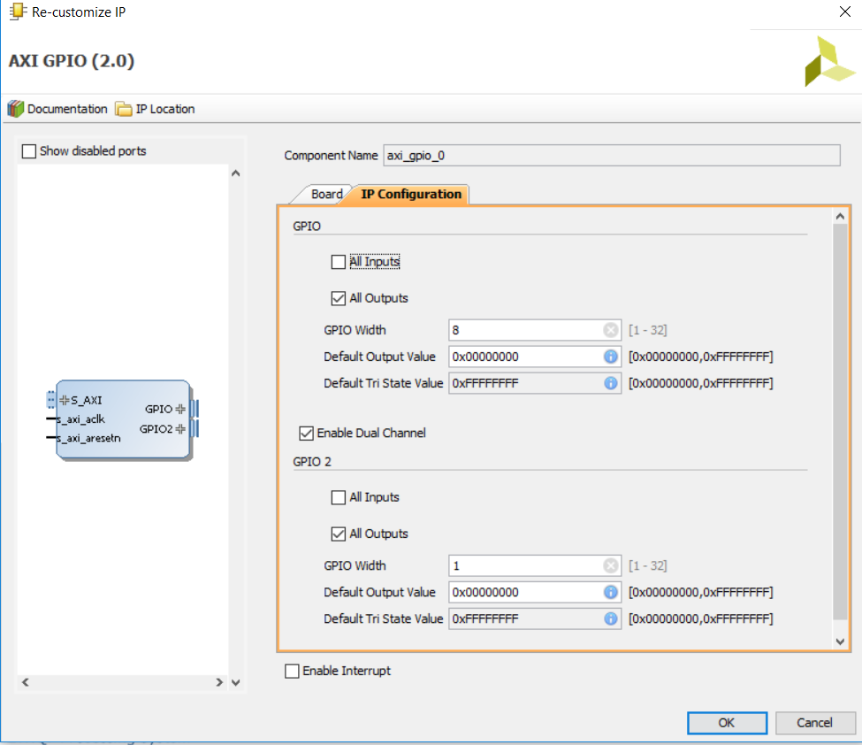
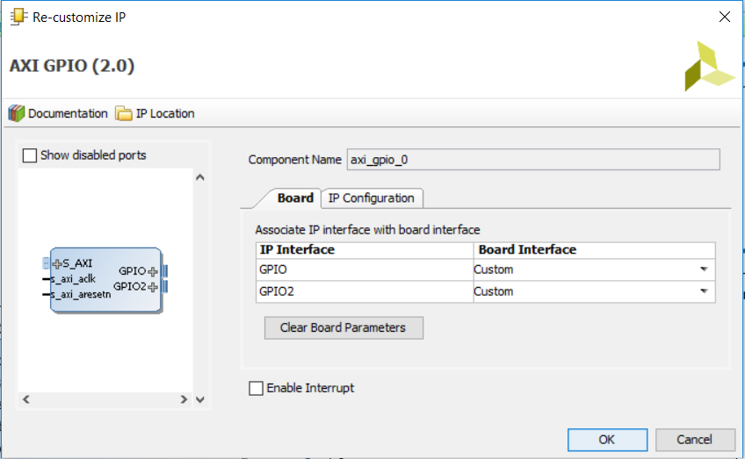
Add AXI_GPIO 0 and 1 to Zynq block design
Add two AXI_GPIO ip to block design
Set gpio 0 to have two channels: 1 and 2 and gpio 1 to have one channel
Choose both channels to be custom
For gpio 0, Set channel 1, to be 8 bit output for tx_data and channel 2 to be 1 bit output for write_to_uart.
For gpio 1, set channel 1 to be 1 bit input for tx_full.

Slide 13

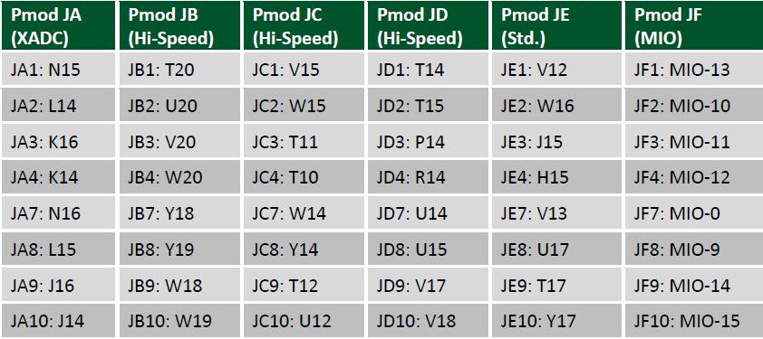
TMP101 Breakout Board Circuit Schematic
TMP101 breakout board
Pin 1 SCL
Pin 2 SDA
Pin 3 GND
Pin 4 V+

Slide 14
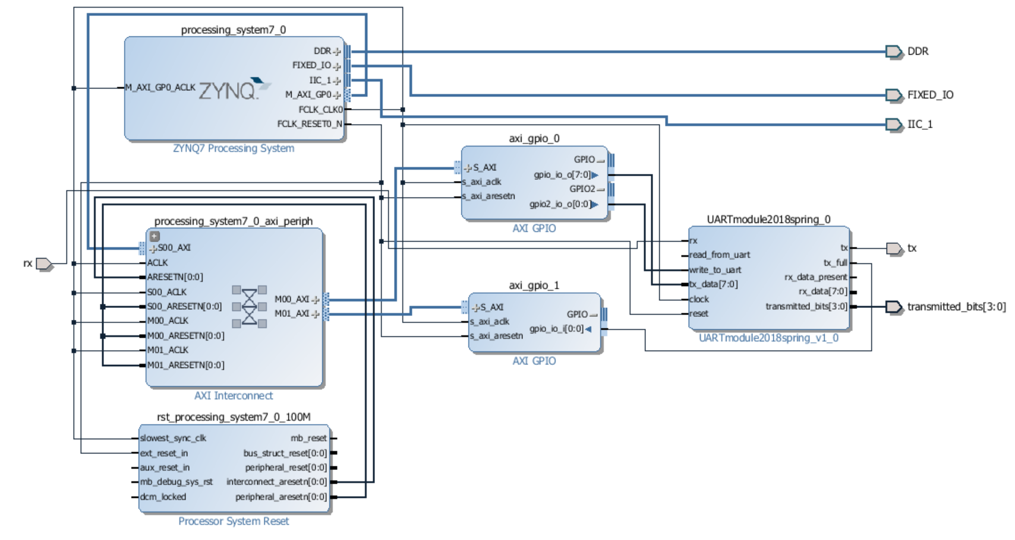
The Block Design
axi_gpio_0 to write to tx_data and write_to_uart
axi_gpio_1 to read from tx_full
Clock is FCLK_CLK0, reset is FCLK_RESET0_N

Slide 15
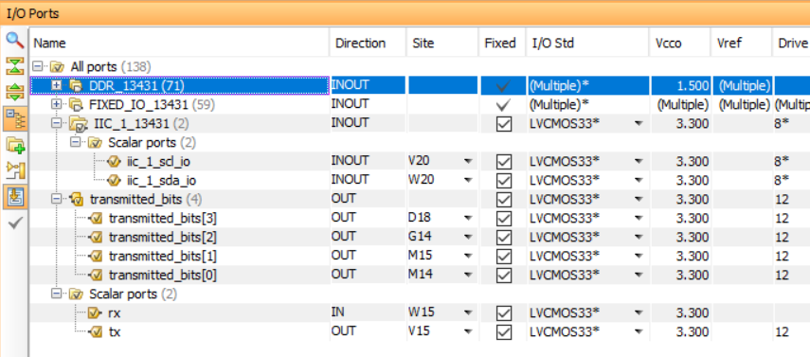
Pin Assignment and xdc file
UART 1 on MIO: MIO 48, MIO 49
I2C 0 on MIO: SCL on MIO 14 (JF9), SDA on MIO 15 (JF10) on Pmod F
I2C 1 on EMIO: SCL on V20 (JB3), rx on W20 (JB4) on Pmod C
Custom uart ip: tx on V15 (JC1), rx on W15 (JC2) on Pmod C

Slide 16
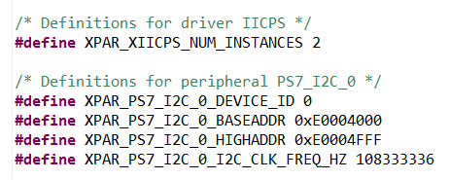
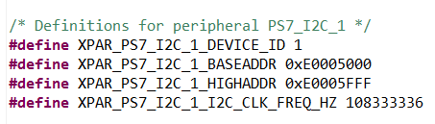
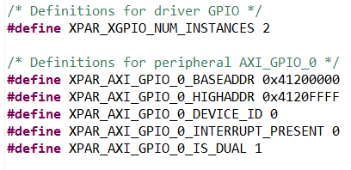
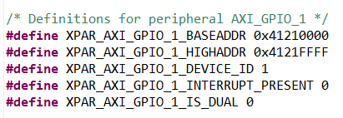
Launch SDK and Create a Software Project
I2C 0 Peripheral Device is PS7_I2C_0
Use I2C Software Driver in the PS Block: iicps v2_3
UARTmodule2018spring_v1_0 IP is connected through AXI_GPIO_0 and AXI_GPIO_1
Dual ports on GPIO_0 and single port on GPIO_1
Use XGpio device driver, gpio v4_0

Slide 17
xgpio.c: initialization and Basic Functions
int XGpio_Initialize(XGpio *InstancePtr, u16 DeviceId);
XGpio_Config *XGpio_LookupConfig(u16 DeviceId);
int XGpio_CfgInitialize(XGpio *InstancePtr, XGpio_Config * Config, u32 EffectiveAddr);
void XGpio_SetDataDirection(XGpio *InstancePtr, unsigned Channel, u32 DirectionMask);
u32 XGpio_GetDataDirection(XGpio *InstancePtr, unsigned Channel);
u32 XGpio_DiscreteRead(XGpio *InstancePtr, unsigned Channel);
void XGpio_DiscreteWrite(XGpio *InstancePtr, unsigned Channel, u32 data);

Slide 18
Xgpio Functions for UARTmodule2019spring_v1_0 ip
Define a device
Xgpio uart1;
Initialize the device
XGpio_Initialize(&uart1, XPAR_AXI_GPIO_0_DEVICE_ID);
Set I/O directions to be output for both channel 1 and channel 2
XGpio_SetDataDirection(&uart1, 1, 0x00000000);
XGpio_SetDataDirection(&uart1, 2, 0x00000000);
Write to channel 1 to send an ASCII word
XGpio_DiscreteWrite(&uart1, 1, data);
Write to channel 2 to send write_to_uart=1
XGpio_DiscreteWrite(&uart1, 2, 1);
Write to channel 2 to send write_to_uart signal=0
XGpio_DiscreteWrite(&uart1, 2, 0);

Slide 19
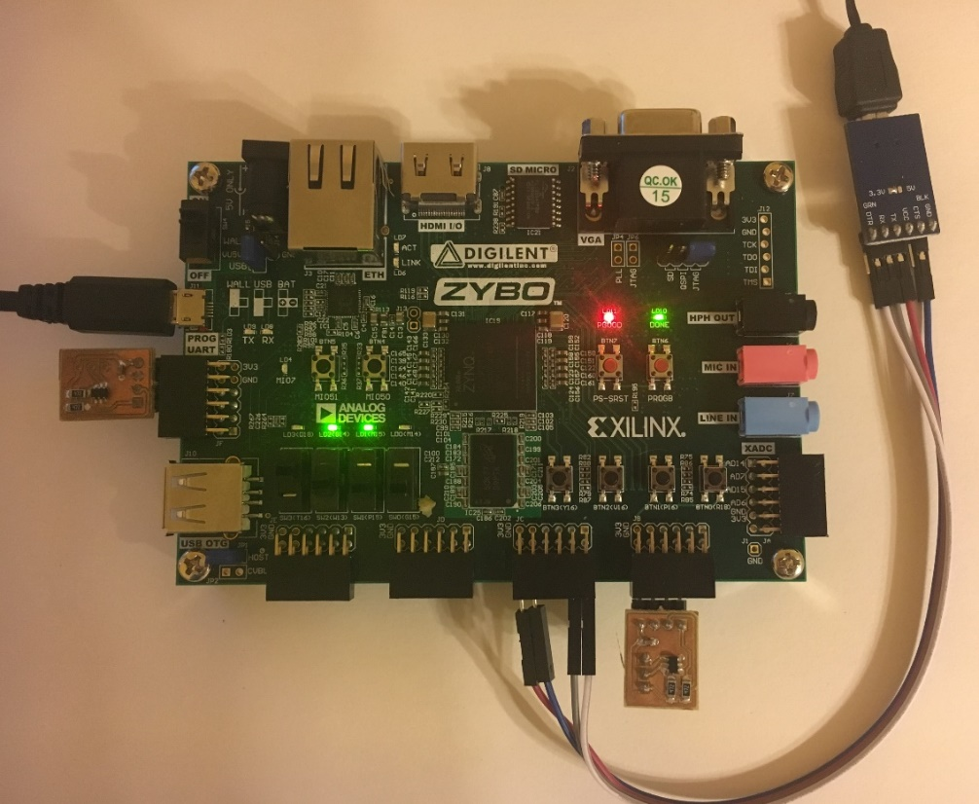
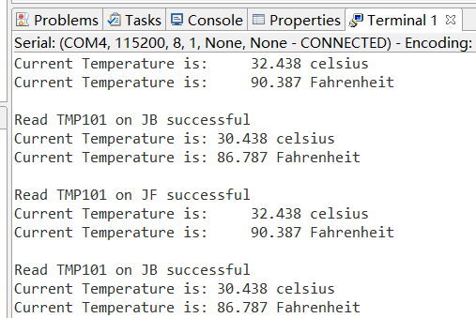
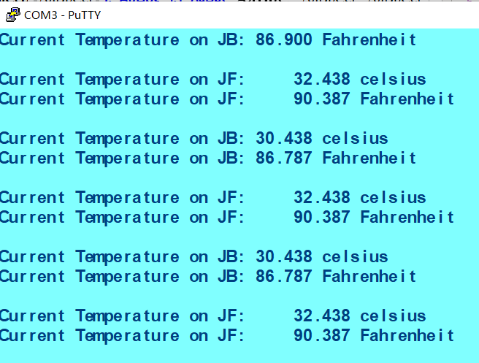
Lab #9 Part 2: two TMP101 and two URAT Terminals

Slide 20
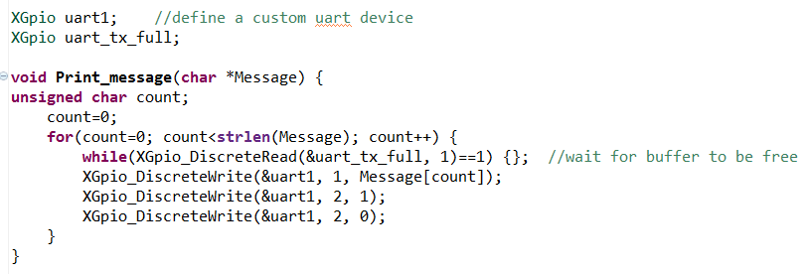
sprintf() to write to a string and send it to the new uart
int sprintf (char *str, const char *format, ….)
printf to a string pointed by str instead of standard terminal.
Return the total number of characters written to str, exclucing the null-character appended at the end of the string. A negative number is returned in case of failure.
Example, char Message[20]; float pi=3.14159; sprintf(Message, “Test sprint to write pi %7.5f”, pi);
//%7.5f specifies 7 total digits and 5 fraction digits.
How to send a string to uart:
strlen(Message)=number of characters
Check to make sure tx_full is false.

